Slide 1
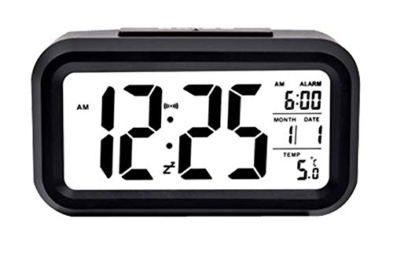
DIGITAL CLOCK
INDIAN INSTITUTE OF TECHNOLOGY PATNA
CS225 - CS226 ARDUINO PROJECT
ARDUINO UNO & 16X2 LCD DISPLAY

Slide 2
Inputs :
4 Push Buttons - Controls & modifies the settings, like regular digital hand watches.
DHT11 - Temperature and Humidity Sensor in the atmosphere.
Outputs :
16x2 Liquid Crystal Display (LCD) - Displays the Digital Time and its other modes.
Piezo Buzzer - Makes beeping sounds to notify when a Alarm and Timer is set.
LED - Blinks along with the Buzzer when a Alarm or Timer is set.
Features :
Mode - 1 : Displays Time (12 and 24 hrs format) and Temperature and Humidity.
Mode - 2 : Displays Date and Day and reminds us important and special dates.
Mode - 3 : Set the Alarm to a desired Time.
Mode - 4 : Stopwatch with start, stop and reset option along with Lap Time calculator.
Mode - 5 : Timer which notifies us with buzzer after a desired time period.

Slide 3
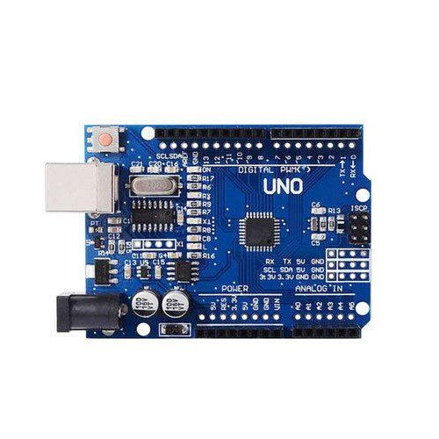
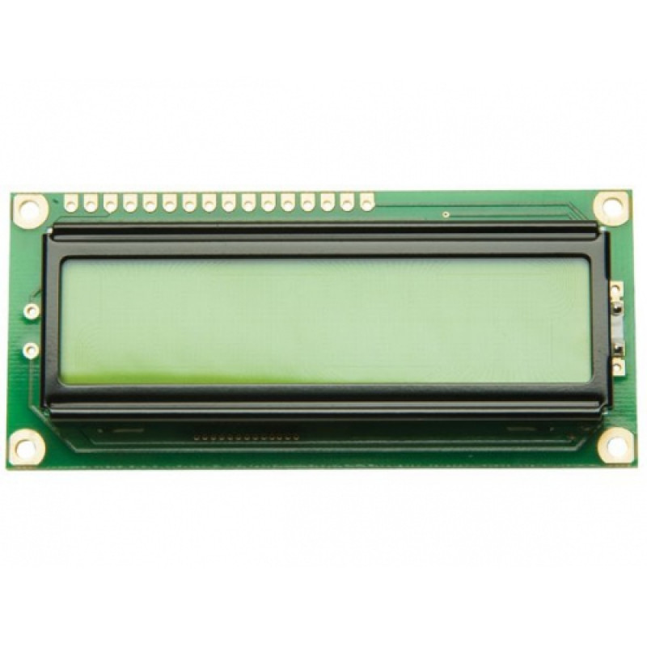
Electrical Components :
ARDUINO UNO
Description : The Uno R3 CH340G ATmega328p Development Board is the low-cost version of the popular Uno R3 Arduino.
Specifications :
Microcontroller ATmega328 (SMD) – Interface CH340G
Operating Voltage: 5V
Input Voltage (limits): 5-20V
Digital I / O Pins 14 (of which 6 provide PWM output)
Analog Input Pins: 6
16 X 2 LCD DISPLAY
Description : This is a basic 16 character by 2 line Alphanumeric display. Black text on Green background.
Specifications :
16 Characters x 2 Lines
Green Backlight
5x7 Dot Matrix Character + Cursor
HD44780 Equivalent LCD Controller/driver Built-In

Slide 4
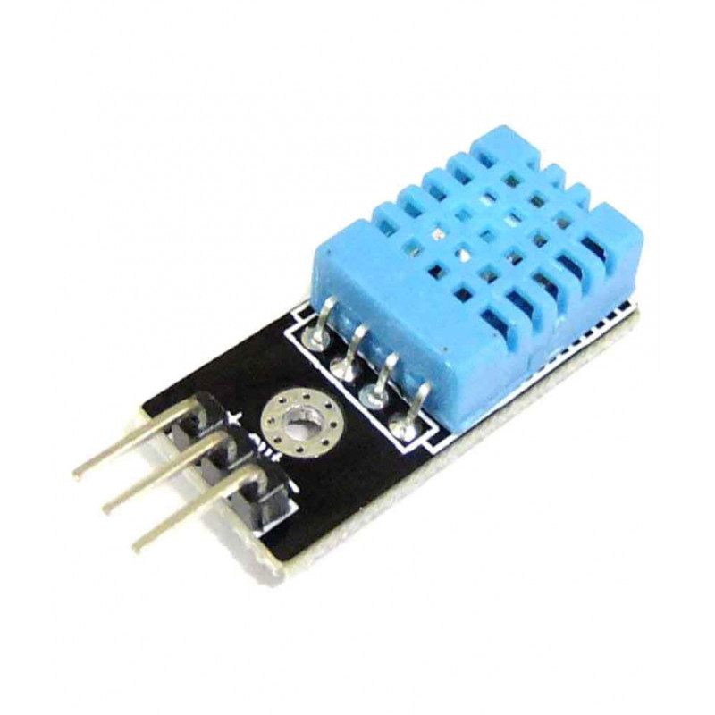
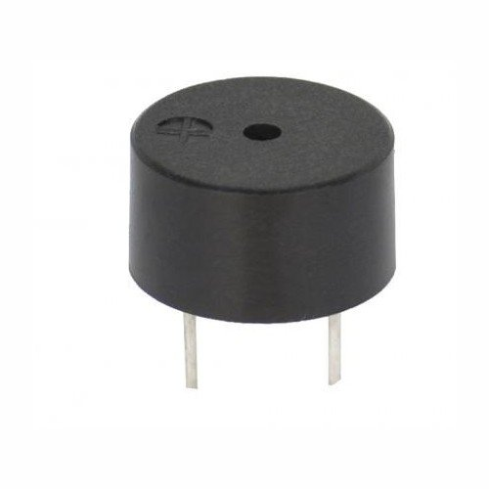
Electrical Components :
DHT11 Temperature and Humidity Sensor
Description : DHT11 is a Humidity and Temperature which generates calibrated digital output.
Specifications :
Power Supply： 3.3~5.5V DC
Output： 4 pin single row
Measurement Range： Humidity 20-90%RH， Temperature 0~50℃
Piezoelectric Buzzer Beeper Alarm
Description : Piezoelectric Buzzer produces sound based on the the piezoelectric effect.
Specifications :
Operating voltage: 4v to 8v
Oscillator frequency: 3.2kHz
Sound level: ≥85dB

Slide 5
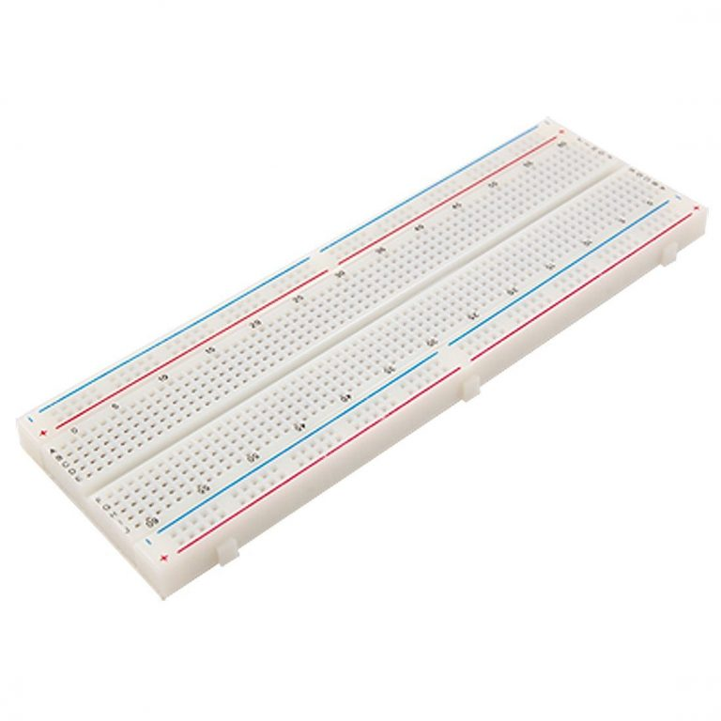
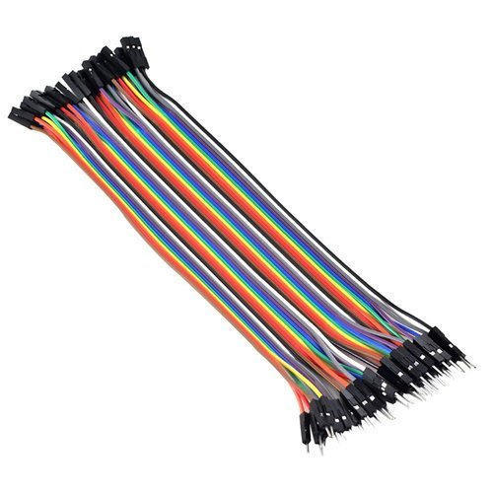

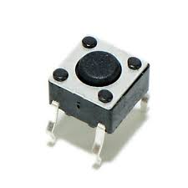
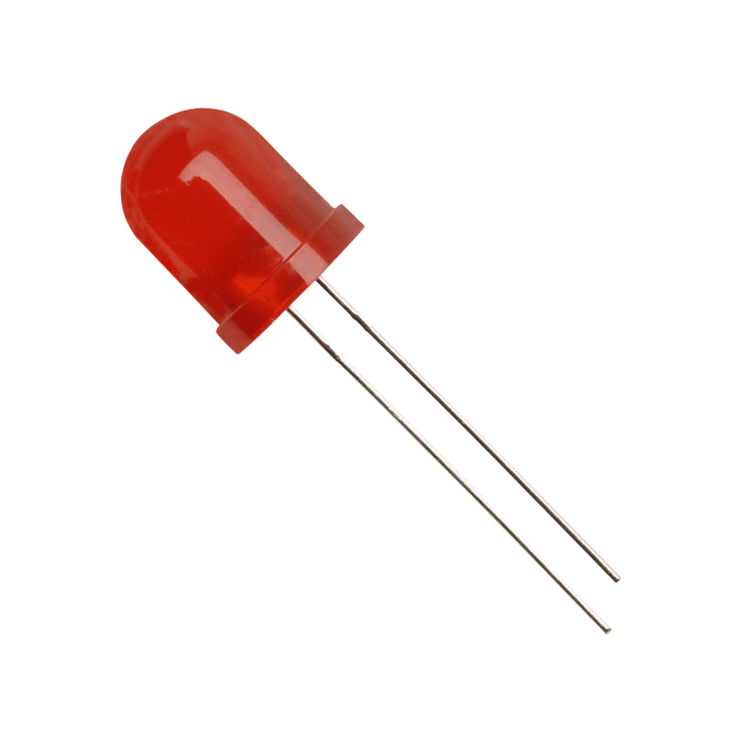
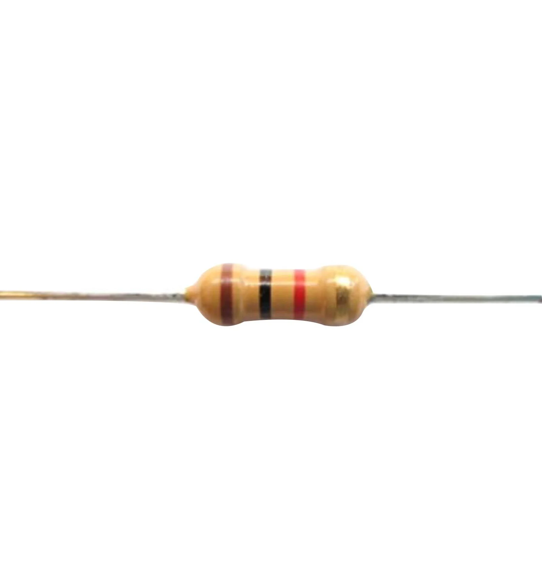
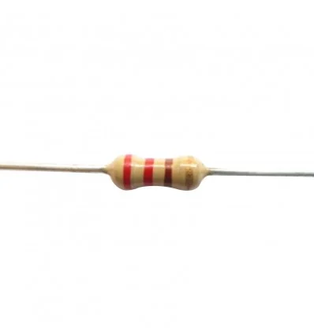
Electrical Components :
Breadboard Male-Male Jumper Wires A to B USB Cable
Resistors Push Buttons (4) LED
1 K ohm resistor (2) 220 ohm resistor

Slide 6
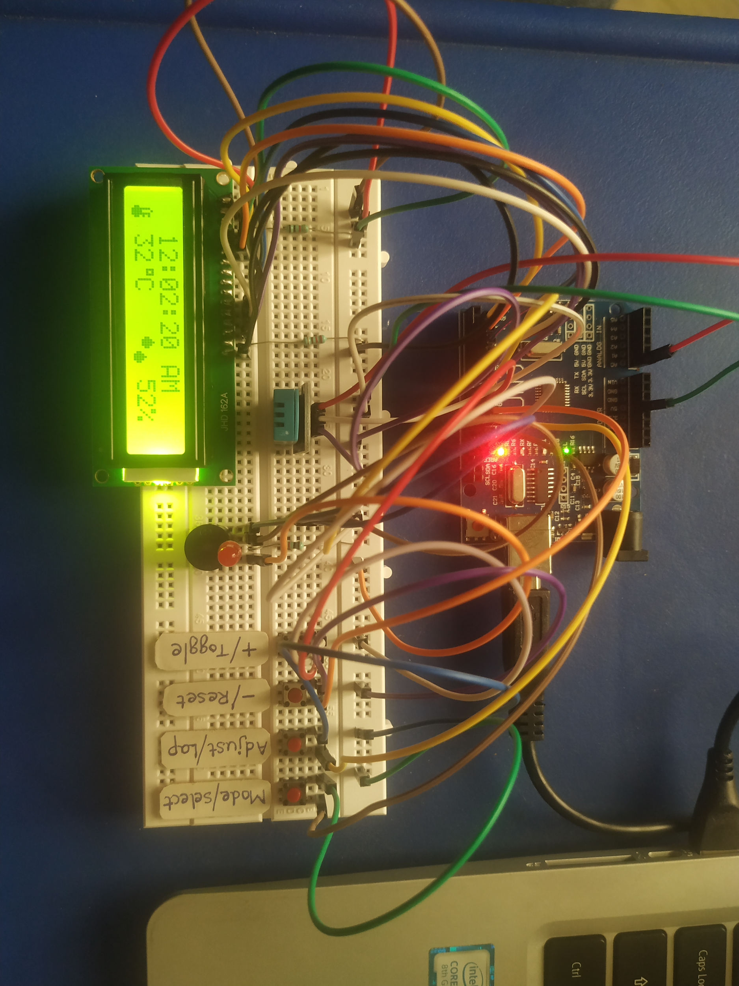
Circuit and Components :
ARDUINO UNO
Jumper Wires
Resistors
4 Push Buttons
LED
DHT11
Buzzer
Breadboard
16 x 2 LCD

Slide 7
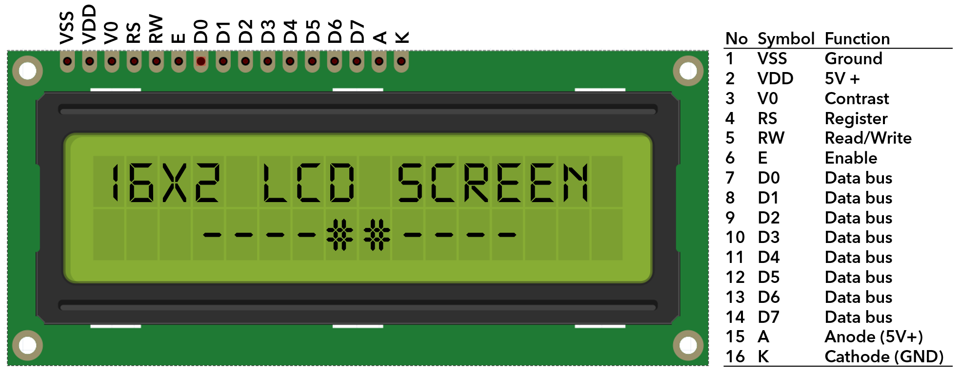
16 x 2 Liquid - Crystal Display (LCD) :
The liquid crystal display uses the property of light monitoring of liquid crystal and they do not emit the light directly. The Liquid crystal display is a flat panel display or the electronic visual display. With low information, content the LCD’ s are obtained in the fixed image or the arbitrary image which are displayed or hidden like present words, digits, or 7 segment display. The arbitrary images are made up of large no of small pixels and the element has larger elements.
Registers of LCD : A 16×2 LCD has two registers like data register and command register. The RS (register select) is mainly used to change from one register to another. When the register set is ‘0’, then it is known as command register. Similarly, when the register set is ‘1’, then it is known as data register.

Slide 8
Command Register : The main function of the command register is to store the instructions of the command which are given to the display. So that predefined tasks can be performed such as clearing the display, initializing, set the cursor place, and display control. Here commands processing can occur within the register.
Data Register : The main function of the data register is to store the information which is to be exhibited on the LCD screen. Here, the ASCII value of the character is the information which is to be exhibited on the screen of LCD.
Features of LCD16x2
The operating voltage of this LCD is 4.7V-5.3V
It includes two rows where each row can produce 16-characters.
The utilization of current is 1mA with no backlight
Every character can be built with a 5×8 pixel box
The alphanumeric LCDs alphabets & numbers
Is display can work on two modes like 4-bit & 8-bit
These are obtainable in Blue & Green Backlight
It displays a few custom generated characters

Slide 9
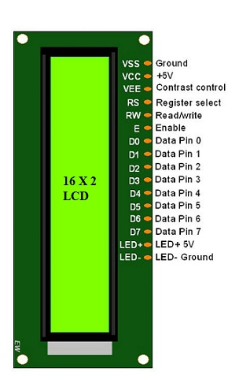
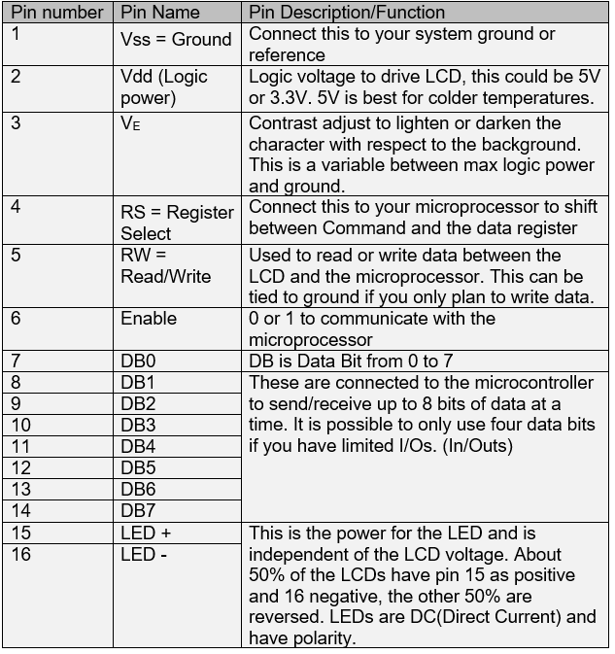
16x2 LCD Pin Configuration :

Slide 10
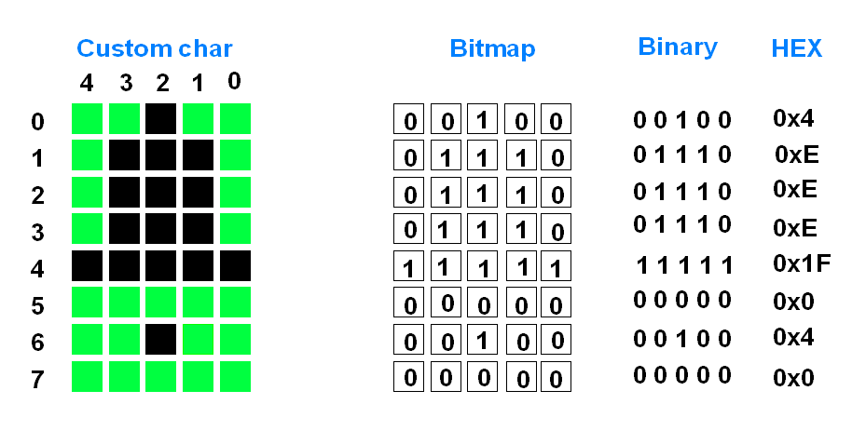
Building Custom Character in LCD :
On LCD16x2 one character is made up by 5 x 8 pixel matrix. Consider that we have to design Bell shape custom character. As in diagram, we have to define pixel values, 0 for pixel OFF and 1 for Pixel ON. The final 8 values are loaded to the CGRAM one by one. The last row is usually left blank (0x00) for the cursor. If you are not using cursor then you can make use of that 8th row to get a bigger pattern.

Slide 11
DHT11 - Temperature and Humidity Sensor :
Temperature : Temperature refers to how hot or cold the atmosphere is, and measured in two ways: Celsius (C) and Fahrenheit (F) usually.
Relative Humidity : Relative humidity is given as a percentage and tells you how close the air is to being saturated with water vapour.
DHT11 is a Humidity and Temperature Sensor, which generates calibrated digital output. DHT11 can be interface with any microcontroller like Arduino, Raspberry Pi, etc. and get instantaneous results. DHT11 is a low cost humidity and temperature sensor which provides high reliability and long term stability. It uses a capacitive humidity sensor and a thermistor to measure the surrounding air, and outputs a digital signal on the data pin (no analog input pins needed). This module makes is easy to connect the DHT11 sensor to an Arduino or microcontroller as includes the pull up resistor required to use the sensor. Only three connections are required to be made to use the sensor - Vcc, Gnd and Output. It has high reliability and excellent long-term stability, and temperature & humidity sensing technology.

Slide 12
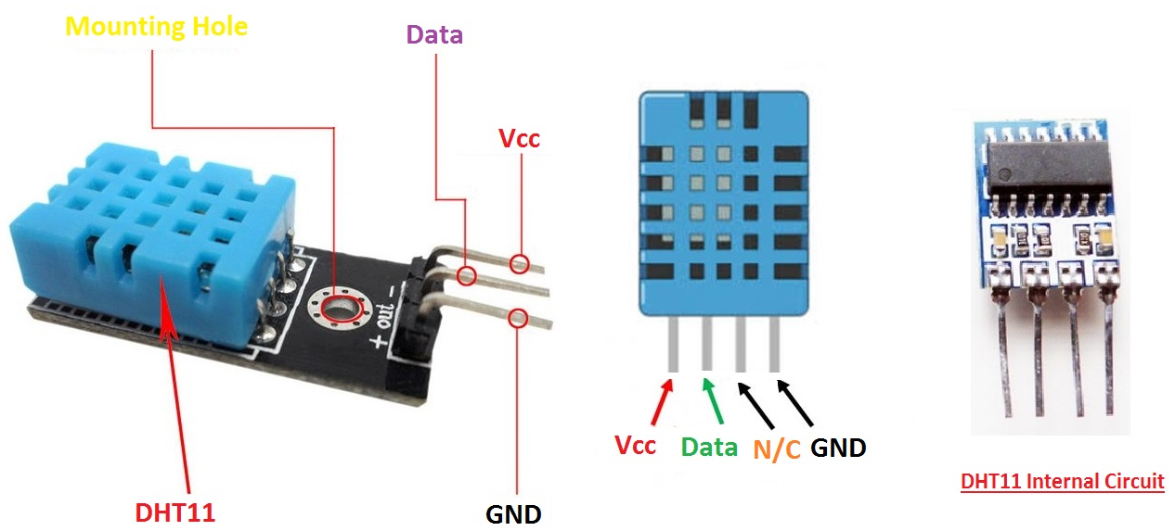
Specifications:-
Power Supply： 3.3~5.5V DC
Output： 4 pin single row
Measurement Range： Humidity 20-90%RH， Temperature 0~50℃
Accuracy： Humidity +-5%RH， Temperature +-2℃
Resolution： Humidity 1%RH， Temperature 1℃
Interchangeability： Fully Interchangeable
Long-Term Stability： <±1%RH/year
Pin Description:-
Pin 1: Power +Ve (3.3VDC to 5.5VDC)
Pin 2: Serial Data Output
Pin 3: Power Ground or Power –Ve

Slide 13
Working Principle of DHT11 Sensor :
DHT11 sensor consists of a capacitive humidity sensing element and a thermistor for sensing temperature. The humidity sensing capacitor has two electrodes with a moisture holding substrate as a dielectric between them. Change in the capacitance value occurs with the change in humidity levels. The IC measure, process this changed resistance values and change them into digital form.
For measuring temperature this sensor uses a Negative Temperature coefficient thermistor, which causes a decrease in its resistance value with increase in temperature. To get larger resistance value even for the smallest change in temperature, this sensor is usually made up of semiconductor ceramics or polymers.
The temperature range of DHT11 is from 0 to 50 degree Celsius with a 2-degree accuracy. Humidity range of this sensor is from 20 to 80% with 5% accuracy. The sampling rate of this sensor is 1Hz .i.e. it gives one reading for every second. DHT11 is small in size with operating voltage from 3 to 5 volts. The maximum current used while measuring is 2.5mA.

Slide 14
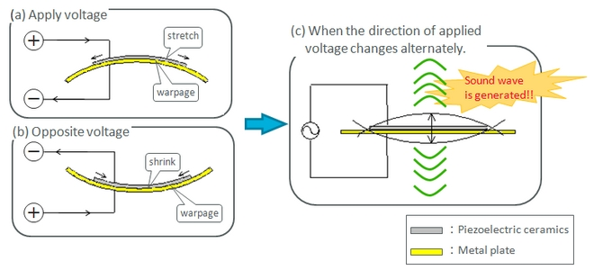
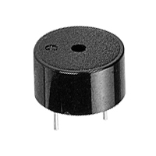
Piezo Buzzer Working Principle :
The piezoelectric buzzer uses the piezoelectric effect of the piezoelectric ceramics and uses the pulse current to drive the vibration of the metal plate to generate sound. Piezoelectric buzzer is mainly composed of multi-resonator, piezoelectric plate, impedance matcher, resonance box, housing, etc. Some of the piezoelectric buzzers are also equipped with light-emitting diodes.
The multi-resonator consists of transistors or integrated circuits. When the power supply is switched on (1.5~15V DC operating voltage), the multi-resonator oscillates and outputs 1.5~2.5kHz audio signal. The impedance matcher pushes the piezoelectric plate to generate sound. The piezoelectric plate is made of lead zirconate titanate or lead magnesium niobate piezoelectric ceramic, and silver electrodes are plated on both sides of the ceramic sheet. After being polarized and aged, the silver electrodes are bonded together with brass or stainless steel sheets.

Slide 15
Online Simulation :
I have designed an online simulation circuit, before I proceed to work with real electronic components. I have uploaded the code in the online simulator. One can try out the online simulation at the link provided here : https://www.tinkercad.com/things/hyBLtSn4fqw
Guide :
In online simulation, the circuit has four push buttons to adjust the settings in Clock.I mimicked the Original Digital hand watches and designed the 4 push buttons to adjust the settings.
Toggle/+ : Used to increment or toggle any setting in the Digital Clock.
Reset/- : Used to decrement or reset any setting to Start in the Clock.
Adjust/Lap : Used to adjust a particular setting or creating a Lap in Stopwatch.
Mode/Select : Used to select a mode and change the setting accordingly.
Note : The online simulator does not support DHT11 library, so we have not included the functionality of Temperature and humidity Sensor, but we included in real circuit.

Slide 16
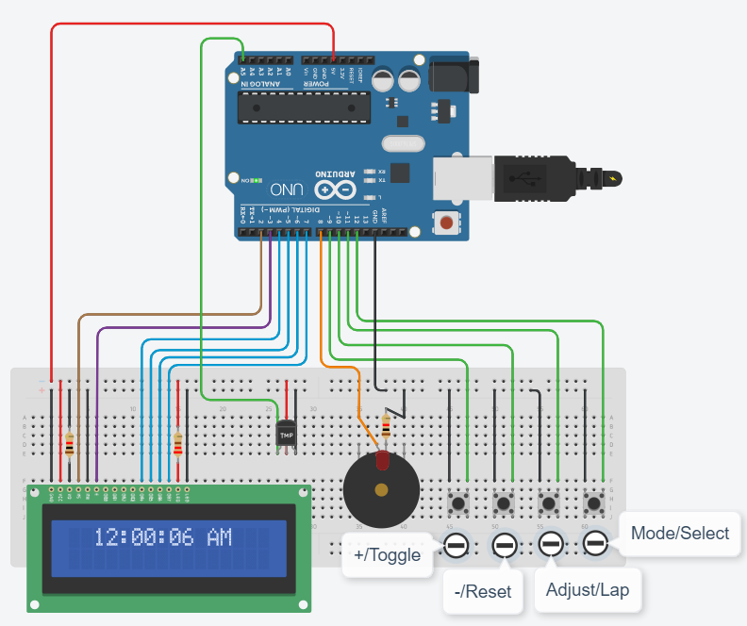
Simulation Circuit Design :

Slide 17
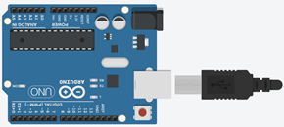
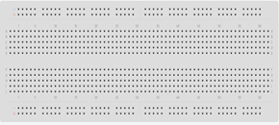
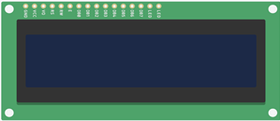




Components Used :
Arduino UNO 16x2 LCD Display 830-Point Breadboard
LED 220 Ohm 1K ohm
Piezo Buzzer DHT11 Sensor Push Button Connecting Wires

Slide 18
Working of the Digital Clock :
The Aim of this Project is to build a Digital Clock which includes the following features:
Mode - I : Displays Time (in 12/24 hr format), Temperature (in °C/°F/K) and Relative Humidity (in %). Setting Time and Changing Formats/Units can be done using the Push Buttons.
Mode - II : Displays Date and Day along with the Scrolling Text if that particular date indicates National Holiday. Setting Date can be done with the help of Push Buttons.
Mode - III : Displays the Alarm Time and the ON/OFF status of the Alarm. A Bell Icon is displayed irrespective of the mode only if the Alarm is ON. The Buzzer for the Alarm rings for 1 - Minute from the moment the Clock Time matches the Alarm Time. Setting Alarm Time, ON/OFF and Stopping Alarm (if ringing) can be done by operating Push Buttons..
Mode - IV : Displays the StopWatch. Start/Stop, Lap(time b/w two splits) and Reset can be done with the use of Push Buttons.
Mode - V : Displays Timer. Set Timer, Start/Stop and Reset can be done by making use of Push Buttons

Slide 19
Declaration :
I hereby declare that I have done my CS 225-226 Project titled “Arduino Digital Clock” along with my teammate and we did not copy any of the Code and Circuit Design from any External Sources. We developed everything from the scratch.
Group Members :
Batturi Jaswanth - 1901CS13
Bhavan Dondapati - 1901CS14

Slide 20
My Contributions :
Designed the Circuit for Online Simulator from scratch in tinkercad simulator.
Integrated the components of Piezo Buzzer Alarm and DHT11 - Temperature and Humidity Sensor with the circuit.
Designed four Input Push Buttons in a optimized way, to control all the settings in the Digital Clock.
Developed the code for mode features and included the functions just like the real world Digital hand watches.
Programmed the code for Time in 12 hour format with precision upto seconds and settings to modify the time (mode - 1).
Programmed the dependency of Date and Day, which ensures that they are in sync always (mode - 2).
Code for Alarm mode notification using Piezo Buzzer and settings to set the desired Alarm time (mode - 3).
Developed the code for stopwatch and also included the Lap functionality to calculate time difference between each Time Stamp (mode - 4).
Code for the Timer, which notifies by triggering the alarm after a given duration of time (mode - 5).

Slide 21
Thank You

